Slide 1

Welcome
Fox Vaccine Information Session
Fox Subacute

Slide 2
What is mRNA?
An RNA vaccine or mRNA vaccine is a type of vaccine that uses a man-made copy of a natural chemical called messenger RNA to produce an immune response.
Unlike most vaccines, which use a modified virus or viral protein to elicit an immune response, the Pfizer-BioNTech vaccine, as well as the vaccine from Moderna, both use messenger RNA (mRNA) to instruct the body to begin defending itself against COVID-19.
Fox Subacute

Slide 3
Brief History of mRNA
1946: ENIAC (Electronic Numerical Integrator and Computer), was the first programmable, electronic, general-purpose digital computer and was develop at the University of Pennsylvania.
1989: Researchers at the Salk Institute, at the University of California-San Diego, demonstrated how to introduce instructions using mRNA into cells for recalibration.
1990-2003: The Human Genome Project, a 13-year joint effort using computers to “Map” the sequence of all human genes.
1990-2004: Numerous developments indicating that RNA could be used as a vaccine to elicit an immune response against a pathogen.
Fox Subacute

Slide 4
Brief History of mRNA for Vaccines (2)
2005-2019: Building upon the gene mapping of the humane genome and using computers to map the genes of viruses, Drew Weissman, MD, PhD, at the University of Pennsylvania and others published a joint paper that solved one of the key technical barriers by using modified nucleosides to get mRNA inside human cells without setting off the body's defense system. Extensive research by Bio-medical companies utilizing the mRNA methodology to develop effective drugs for chronic disease such as cardiovascular, metabolic, renal, and some cancers resulted in mixed results. Vaccine research continued with mRNA but with less focus due to the narrow profit margins involved with vaccine development.
2020: COVID-19 became a pandemic and the US government stepped in and funded development costs (except for Pfizer).
While it may seem that mRNA vaccines developed at Warp Speed within this year, actually, it has been 74 years in the making.
Fox Subacute

Slide 5
Geni Fisher
Chief Clinical Officer
Fox Subacute
Fox Subacute

Slide 6
Manager of Clinical Operations, Pharmerica
Jim Mooney, R.Ph.: is the Manager of Clinical Operations for Pharmerica, overseeing the East Central District. He holds a license to practice as a Pharmacist in both Pennsylvania and Maryland and has completed certification to administer immunizations in Pennsylvania. His current responsibilities include day to day supervision of a dedicated group of knowledgeable Consultant Pharmacists in his district, providing educational opportunities to his team and most importantly, focusing on the needs of the patient to provide safe and effective medication therapies. He is a proud graduate of the Philadelphia College of Pharmacy and Science, and has practiced in a variety of clinical settings, from acute care, community and long-term care, over his career.
Fox Subacute

Slide 7
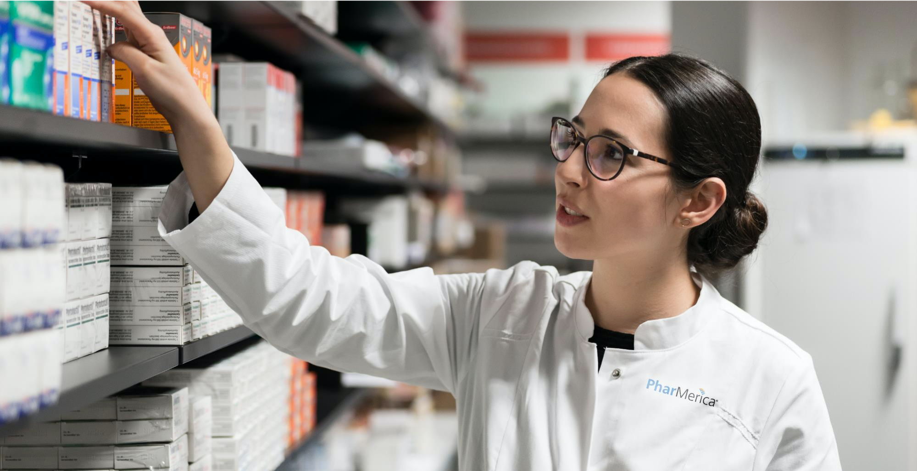

Covid-19 (SARS CoV-2) Vaccine
James J. Mooney II, RPh
Manger, Clinical Operations
12/21/2020

Slide 8
Safe and Effective Vaccine Development
 | PRE-CLINICAL TRIAL | PHASE 1 | PHASE 2 | PHASE 3 | PHASE 4 (POST-MARKETING)
SUBJECTS | Trials in animals | Small number of healthy subjects (<100) | Larger number of subjects (100s) | Largest number of subjects (1,000s) More diverse population | General population, including those with immunocompromising conditions
OBJECTIVES | Safety Immunogenicity Feasibility | Safety Immunogenicity Safe dose range | Safety Immunogenicity | Safety (uncommon adverse events) Efficacy (how well vaccine prevents disease) | Safety (very rare adverse events) Effectiveness (how well vaccine prevents disease in general population over time)
KEY POINTS | Critical step before proceeding to human trials | First human trial | Determine the final dose and schedule | Typically randomized, controlled, double-blind trial | Post-licensure safety effectiveness surveillance

Slide 9
Vaccine Types
Different vaccine technologies can be used to trigger the desired immune response:
Of these various types, only three are anticipated for development of a COVID-19 vaccine in the U.S. at this time:
Live Attenuated Vaccines (e.g., influenza, MMR)
Inactivated Vaccines (e.g. Hepatitis A, Polio)
Viral Vectored Vaccines (e.g., Ebola vaccine)
Recombinant-protein Vaccines (HPV)
mRNA Vaccines (advanced technology)
Viral-vectored Vaccines
Recombinant Protein Vaccines
mRNA Vaccines

Slide 10

















What are RNA Vaccines & How do they work?
SARS-CoV-2
Viral RNA
The virus’s genetic material. Contains instructions for making proteins.
Vaccine Production
Spike protein Protein which helps the virus penetrate cells and initiates an infection.
RNA is easy to make in a lab, so RNA vaccines can be developed quicker than other vaccines.
Safety of the Vaccines
RNA can’t cause infection and is broken down by normal processes in our cells. An RNA vaccine hasn’t been licensed for use in humans before but they’ve been under development for several years for other viruses, including influenza, HIV, and Zika.
The genetic code of the SARS-CoV-2 virus is made up of RNA. Scientists isolated the part of this genetic code that contains the instructions for making the virus’s spike protein.
RNA Vaccines: Benefits & Challenges
Lipid Nonoparticles
What are RNA Vaccines?
Storage and Transport
Some RNA vaccines must be stored at low temperatures to remain stable, which makes storage and transport more challenging.
RNA Instructions
Vaccine Shot
Synthetic RNA which codes for the virus spike protein is packed in lipid nonparticles (very small fat droplets). This stops our bodies’ enzymes breaking it down and helps our cells take it in.
RNA Vaccines for COVID-19
Synthetic RNA
Viral protein
Several proposed vaccines for COVID-19 are RNA vaccines.
mRNA vaccines: Moderna • Pfizer & BioNTech • CureVac
Human cell
Immune response
Once the synthetic RNA is inside one of our cells, the cell follows the RNA instructions to produce the virus spike protein. It’s production then triggers an immune response in our bodies.

Slide 11
Status: Vaccine Development
TERMINOLOGY: REACTOGENICITY
In clinical trials, the term reactogenicity refers to the property of a vaccine, that being, the ability to produce common, "expected" adverse reactions, especially excessive immunological responses and associated signs and symptoms, including fever and sore arm at injection site. Other manifestations of reactogenicity typically identified in such trials include bruising, redness, induration, and swelling.

Slide 12
Status: Vaccine Development
Status: Pfizer/BioNTech mRNA BNT162b2
Primary efficacy analysis demonstrates BNT162b2 to be 95% effective against COVID-19 beginning 28 days after the first dose;
170 confirmed cases of COVID-19 were evaluated, with 162 observed in the placebo group versus 8 in the vaccine group
Efficacy was consistent across age, gender, race and ethnicity demographics; observed efficacy in adults over 65 years of age was over 94%
Data demonstrate vaccine was well tolerated across all populations with over 43,000 participants enrolled; no serious safety concerns observed; the only Grade 3 adverse event greater than 2% in frequency was fatigue at 3.8% and headache at 2.0%
The companies expect to produce globally up to 50 million vaccine doses in 2020 and up to 1.3 billion doses by the end of 2021

Slide 13
Status: Vaccine Development
Status: Moderna’s mRNA-1273
Started phase 3 clinical trials July 27th
As of October, had administered doses to 30,000 participants (including second doses to more than 25,000 participants).
Two doses using 28-day interval; cold storage
Efficacy via Press Release of 94%
FDA Approved Moderna vaccine December 18, 2020 for Emergency Use

Slide 14
Points of Information: Facts
Emergency Use Authorization versus Full FDA Approval, (development was not too fast to be safe)
Vaccines are not “Political”
You will not be “chipped and tracked”
Peak effect achieved 14 days after the second dose of the vaccine
Reactogenicity: Mostly mild to moderate side effects, increasing with second dose; some risk of more severe reactions
Vaccine will not be federally mandated
Until a majority of the population receives the vaccine, masks will still need to be worn, social distancing is still recommended (Herd Immunity)
ACIP Committee Meetings are held publicly
VAERS is used to track and monitor adverse events
Vaccines are available at no cost if they are part of the federal program

Slide 15
Build Support
Only safe and effective COVID-19 vaccines that have been rigorously tested in large, well-designed studies with tens of thousands of volunteers will be available.
COVID-19 vaccines are following the same rigorous, multi-phased testing process as every other vaccine.
COVID-19 vaccine development is moving faster than normal because our top medical experts have made it their highest priority, not because steps in the testing process are being skipped.
The FDA will share information about authorized or approved COVID-19 vaccines so you can see the scientific evidence for yourself.
COVID-19 vaccine developers are trying to make sure their clinical trials reflect the nation's diversity, because these vaccines must be proven safe and effective for everyone.
Medical experts and career public health officials, not politicians or their appointees, will decide when a COVID-19 vaccine is safe, effective, and ready for public use.

Slide 16
FDA Track Record for Vaccine Approval
“Post-marketing Safety of Vaccines”
CONCLUSIONS
The vast majority of vaccines approved by FDA were found to be remarkably safe
The FDA approval process, and the VAERS surveillance program, are excellent

Slide 17
Safe and Effective Vaccine Development
In the history of vaccines, 90 to 95% reveal their long-term side effects within 30 to 45 days after their final dose. (Dr. Fauci Says You Should Expect These COVID Vaccine Side Effects, November 30, 2020)

Slide 18
Sources
Much of the information from the above presentation was compiled from the following resources:
American College of Medical Toxicology (ACMT):
  Webinar: Monitoring Safety of Vaccines
  Post-Marketing Safety of Vaccines Approved by the U.S. Food and Drug Administration
  Narayan Nair, MD, Director, Division of Epidemiology, Office of Biostatistics and Epidemiology, Center for Biologics Evaluation and Research, U.S. Food and Drug Administration
  Webinar: Update on COVID-19 Vaccine Clinical Trials: Are We There Yet? Evan Anderson, MD, Professor, Pediatrics and Medicine, Emory University School of Medicine

Slide 19
Sources
(Continued)
Article: Safety and Immunogenicity of SARS-CoV-2 mRNA-1273 Vaccine in Older Adults (NEJM, September 29, 2020)
Press Release: Pfizer and BioNTech conclude Phase 3 Study of COVID-19 Vaccine Candidate, Meeting All Primary Efficacy Endpoints
Press Release: Moderna Announces Primary Efficacy Analysis in Phase 3 COVE Study for Its COVID-19 Vaccine Candidate and Filing Today with U.S. FDA for Emergency Use Authorization

Slide 20
Questions?
Fox Subacute

Slide 21
Final Comments
No vaccine has zero risk, including this one.
It is, despite the speed with which it seems to have been created, the safest vaccine ever made.
This vaccine is the result of 70 years of scientific discoveries and developments and not the swift results of a frenzied rush to achieve political gain.
The risk is outweighed by the benefit.
We wish for you a future which is covid free like so many other afflictions which have been eliminated by vaccines.
Fox Subacute

Slide 22
Thank you for participating in the:
Fox Vaccine Information Session
Fox Subacute

